Slide 1

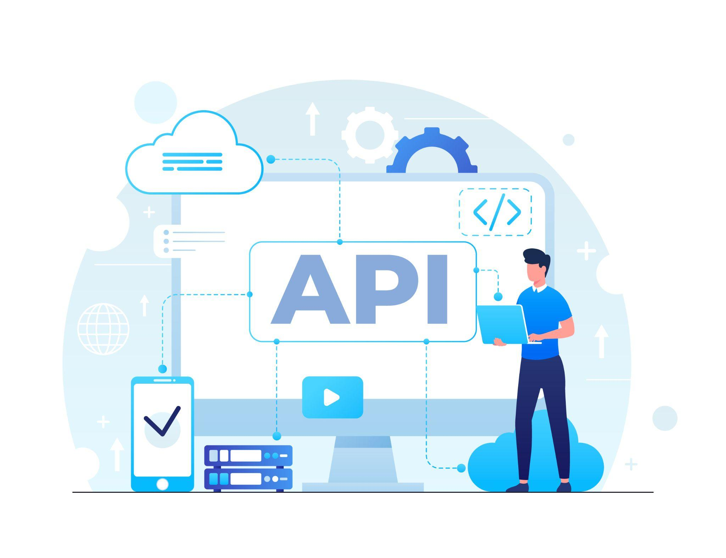


API Testing
B1
Presented by
Farhad Hossain

Slide 2
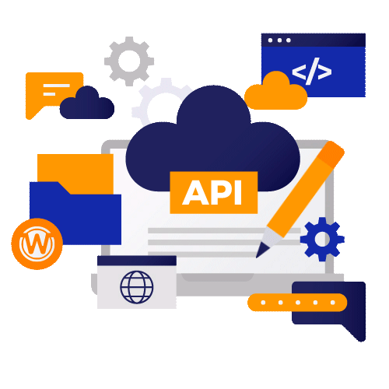
What is API?
API stands for Application Programming Interface. An API is a set of programming code that allows two programs to talk to each other.

Slide 3
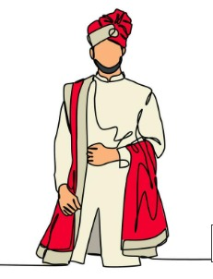
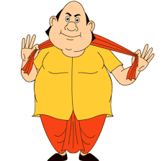

API-Real life example
Request
Request
Response
Response
Groom
Matchmaker
Bride

Slide 4
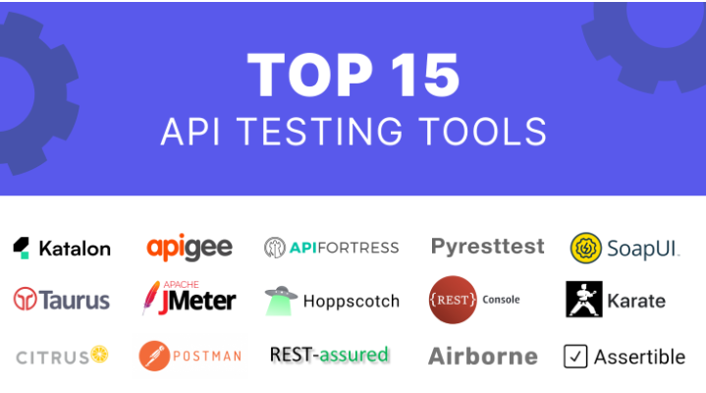

Slide 5
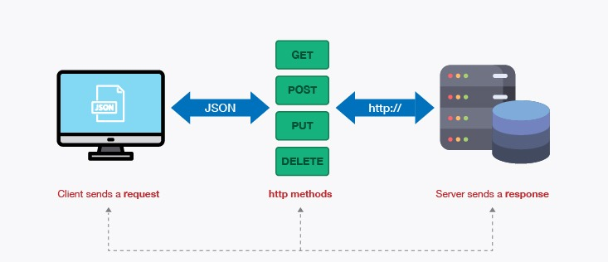
API workflow

Slide 6
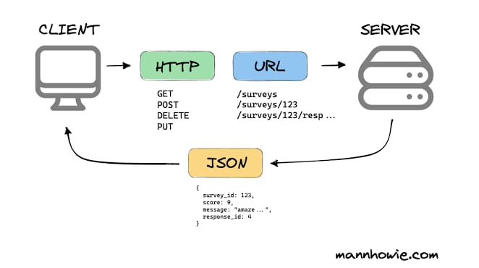
API workflow

Slide 7
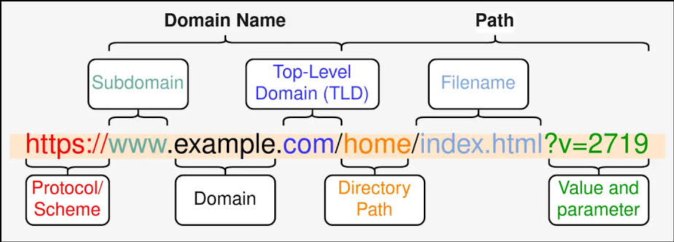
API Structure

Slide 8
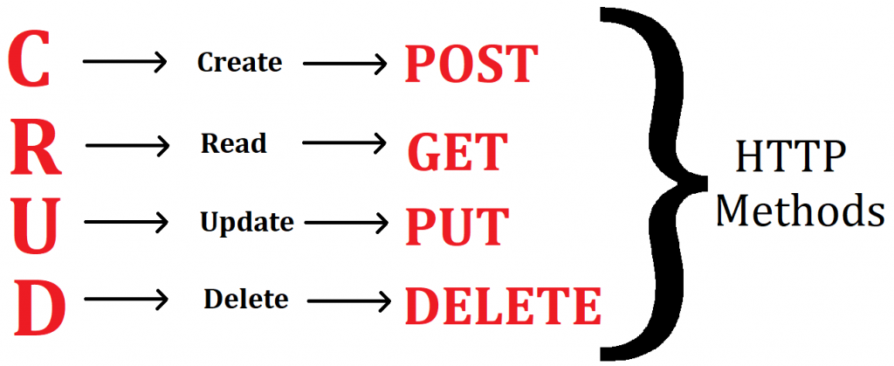
HTTP Methods

Slide 9
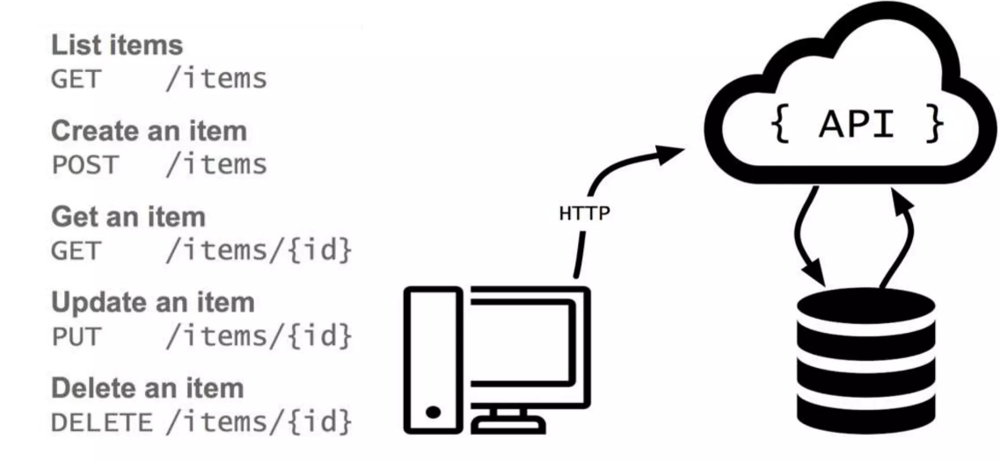
HTTP Methods

Slide 10
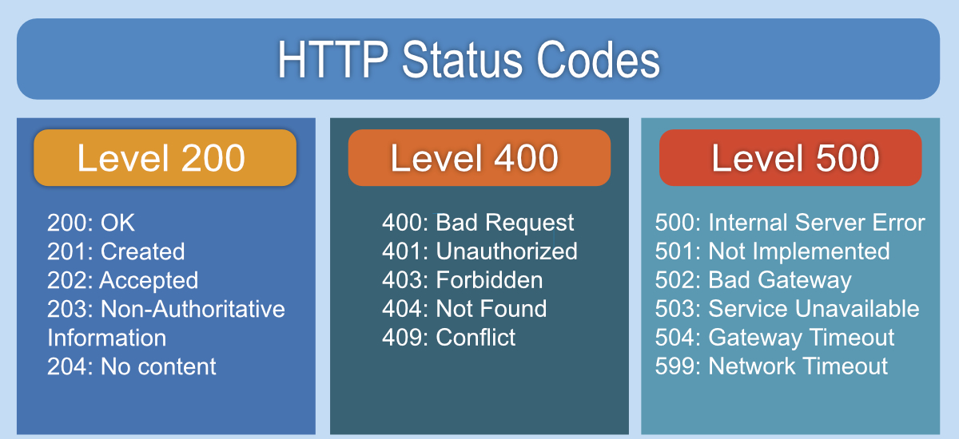
HTTP Status Code

